Slide 1
M
M
L
K
E
S
M
M
M
V
A
M
M
A
D
A
M
B
M
A
L
C
M
E
B
V
M
N
M
B
R
V
M
M
E
S
M
D
M
I
K
P
M
M
H
M
E
C
G
A
V
E
M
M
M
F
I

Slide 2
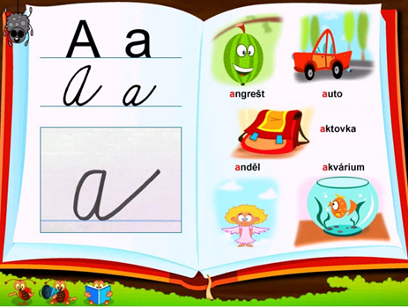
A
M
L
K
E
S
M
A
A
A
A
B
M
C
D
A
A
A
L
A
A
U
Š
A
A
A
B
N
B
A
A
A
B
A
B
S
M
D
O
A
I
A
A
A
K
H
M
E
C
G
A
A
M
B
M
M
F
I

Slide 3
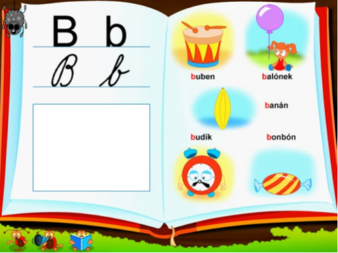
B
M
L
K
E
S
M
M
M
V
B
B
M
A
D
A
B
B
B
A
L
B
M
E
B
B
B
N
B
L
R
B
B
M
B
S
M
D
B
B
I
K
B
M
B
H
M
E
C
G
A
B
B
B
M
M
F
I

Slide 4
D
D
D
K
E
S
M
A
A
A
A
B
D
D
U
A
A
A
L
A
A
U
Š
D
D
D
B
N
B
A
A
A
B
P
B
D
D
D
O
A
I
A
A
A
K
H
M
D
C
G
A
A
M
B
M
M
D
D

